Slide 1
Chapter 1
Introduction to
Web Development

Slide 2
Objectives
Applied
Load a web page into a web browser.
View the source code for a web page in a web browser.
Knowledge
Discuss the components of a web application.
Describe HTTP requests and responses.
Distinguish between the way a web server processes static web pages and dynamic web pages.
Explain the purpose and use of HTML.
Explain the purpose and use of CSS.
Explain the purpose and use of JavaScript.

Slide 3
Objectives (cont.)
Discuss how you deploy a website to the Internet.
Describe the components of an HTTP URL.
Discuss these five web development issues:
Usability
Cross-browser Compatibility
Accessibility
Search Engine Optimization (SEO)
Responsive Web Design

Slide 4
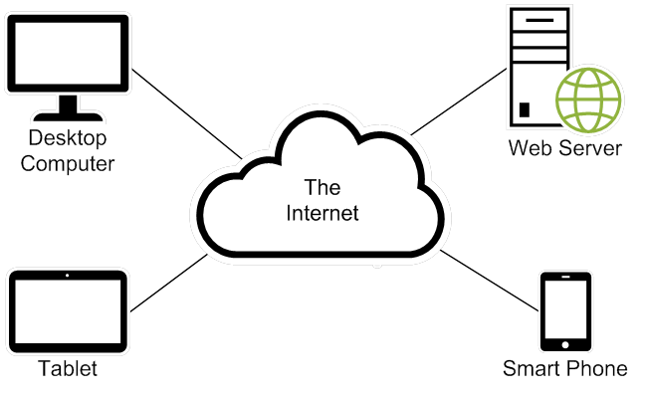
The components of a web application

Slide 5
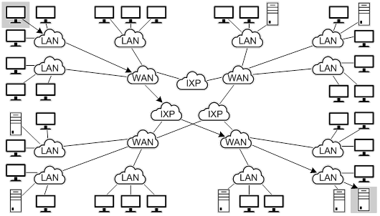
The architecture of the Internet

Slide 6
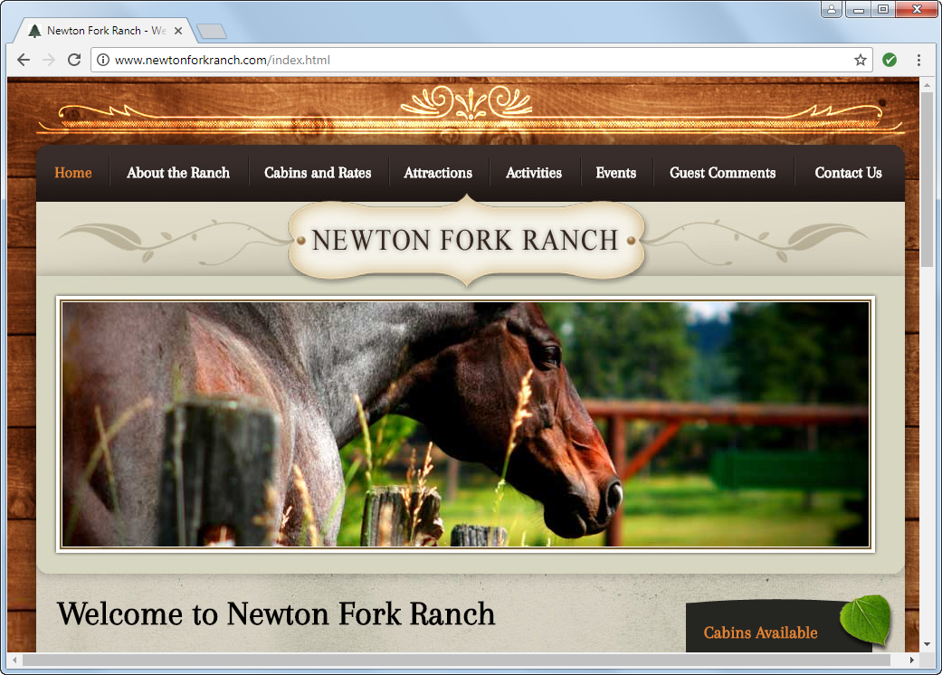
A static web page

Slide 7
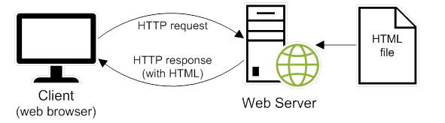
How a web server processes a static web page

Slide 8
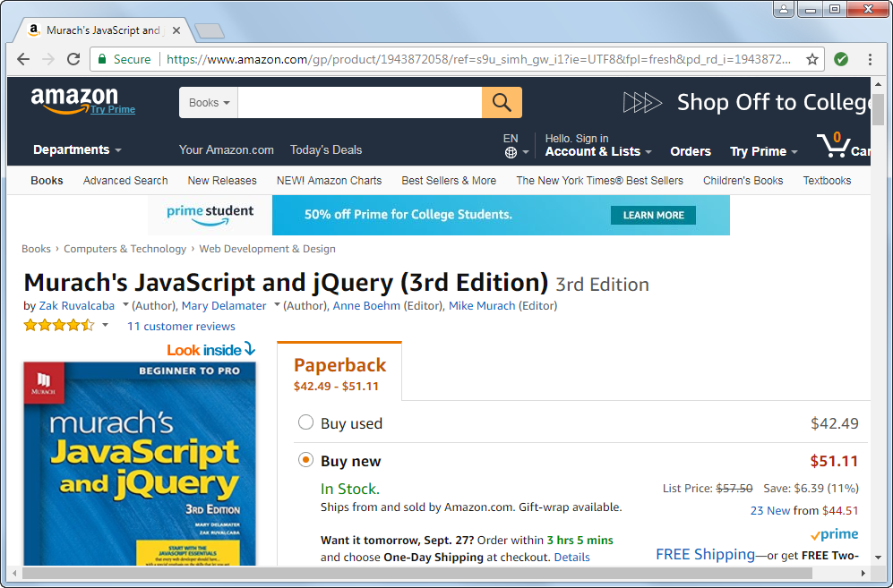
A dynamic web page at amazon.com

Slide 9
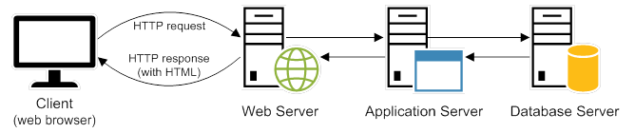
How a web server processes a dynamic web page

Slide 10
How does the Internet work?
Internet Infrastructure as Fast As Possible
https://youtu.be/n71TUnTNdw8
How the Internet Works for Developers - Pt1
https://youtu.be/e4S8zfLdLgQ
How the Internet Works for Developers - Pt2
https://youtu.be/FTAPjr7vgxE

Slide 11
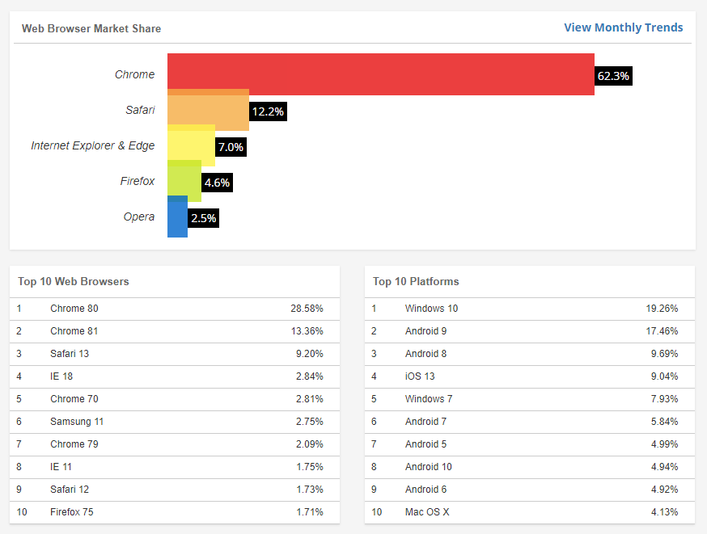
Web Browsers - Current Market Share
https://www.w3counter.com/globalstats.php

Slide 12
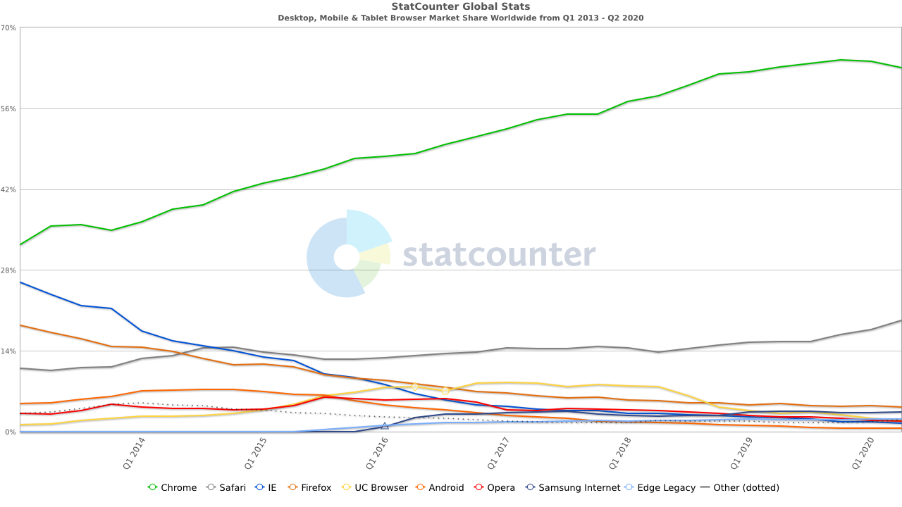
Web Browser - Usage Over Time
https://gs.statcounter.com/browser-market-share/desktop-mobile-tablet/worldwide/#quarterly-201301-202002

Slide 13
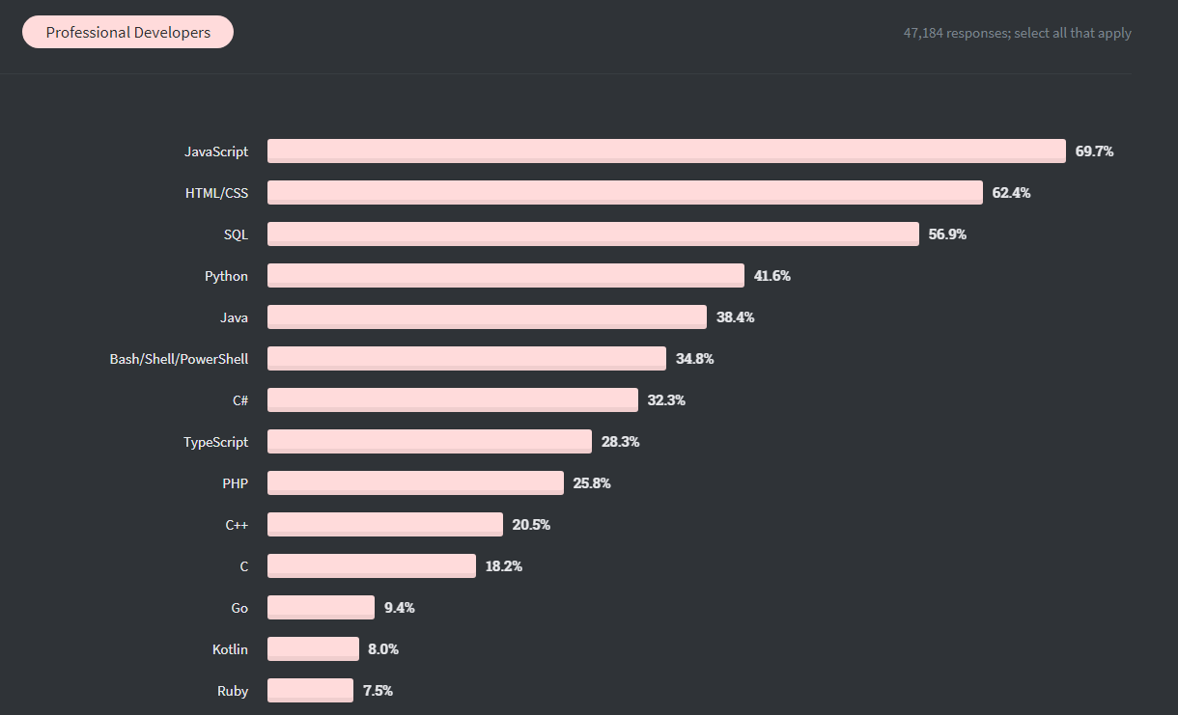
Server-side programming languages
JavaScript
Python
Java
C#
PHP
Ruby
https://insights.stackoverflow.com/survey/2020

Slide 14
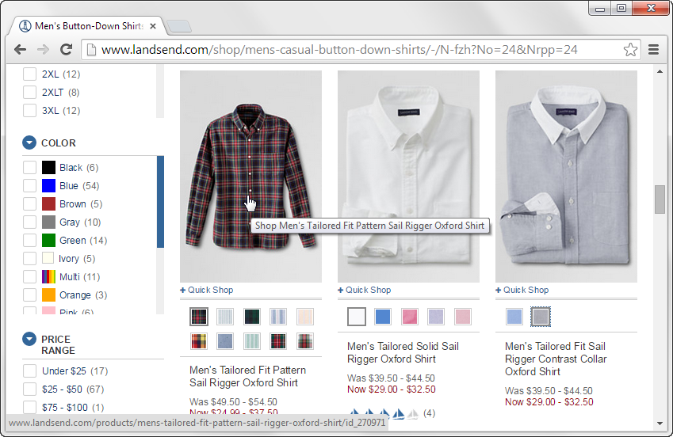
A web page with image swaps and rollovers

Slide 15
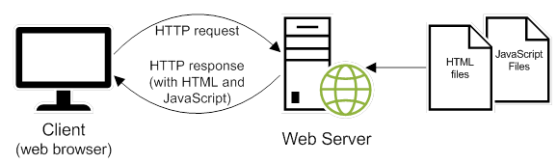
How JavaScript fits into this architecture

Slide 16
Common uses of JavaScript
Interactivity
Data validation
Image swaps and rollovers
Accordions
Asynchronous JavaScript and XML (AJAX)

Slide 17
The code for an HTML file
<!DOCTYPE html>
<html lang="en">
<head>
<meta charset="utf-8">
<title>JavaScript and jQuery book</title>
</head>
<body>
<h1>JavaScript and jQuery (3rd Edition)</h1>
<img src="javascript_jquery.jpg" alt="JavaScript and jQuery Book">
<p>Today, ... does best.</p>
<p>Now, ... <a href="">read more...</a></p>
</body>
</html>

Slide 18
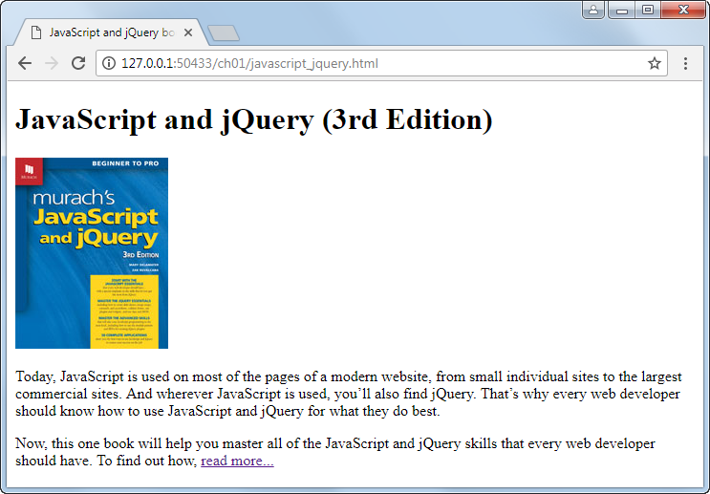
The HTML displayed in a web browser

Slide 19
Use CSS to change how the page looks
HTML is used to create the structure of a web page.
Cascading Style Sheets (CSS) is used to change the look of a web page.

Slide 20
Use <link> element to add a CSS file
...
<head>
<meta charset="utf-8">
<title>JavaScript and jQuery book</title>
<link rel="stylesheet" href="book.css">
</head>
...

Slide 21
The code for the CSS file named book.css
body {
font-family: Arial, Helvetica, sans-serif;
font-size: 100%;
width: 550px;
margin: 0 auto;
padding: 1em;
border: 1px solid navy;
}
h1 {
margin: 0;
padding: .25em;
font-size: 200%;
color: navy;
}
img {
float: left;
margin: 0 1em 1 em 1em; }
p {
margin: 0;
padding-bottom: .5em; }

Slide 22
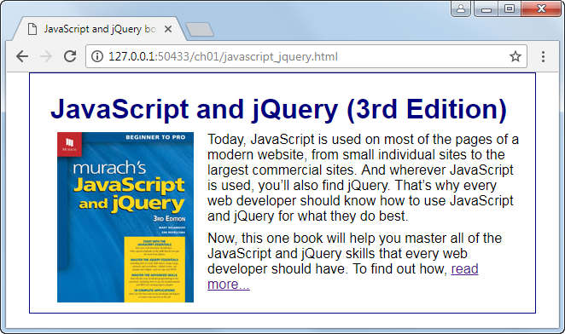
The web page displayed in a web browser

Slide 23
Websites to become familiar with
Mozilla Developer Network (MDN)
Introduction to HTML
https://developer.mozilla.org/en-US/docs/Learn/HTML/Introduction_to_HTML
CSS first steps
https://developer.mozilla.org/en-US/docs/Learn/CSS/First_steps

Slide 24
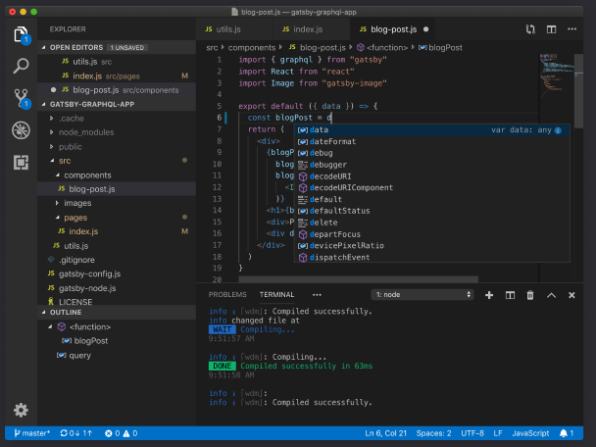
Free text editors
Visual Studio Code
Brackets
Atom
Notepad++

Slide 25
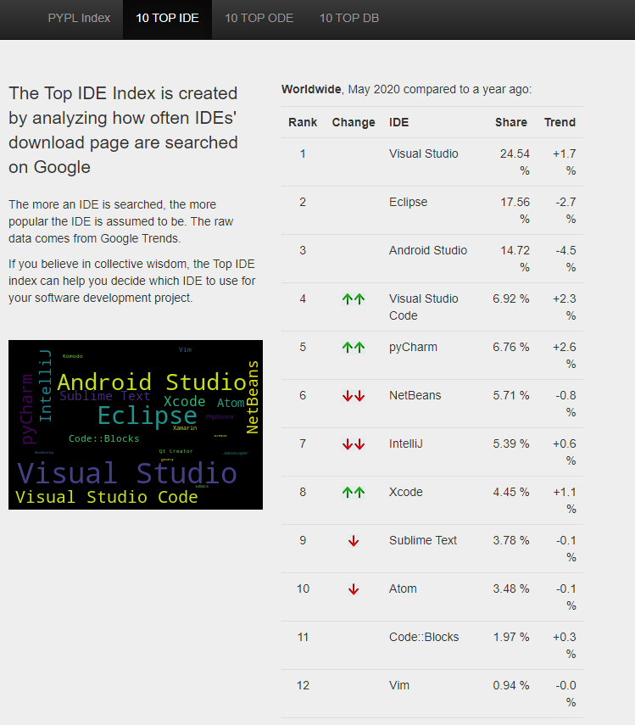
Popular IDEs for web development
Visual Studio Code
Microsoft Visual Studio
NetBeans
IntelliJ IDEA
Brackets
Atom
https://pypl.github.io/IDE.html

Slide 26
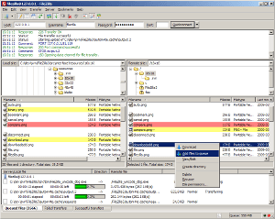
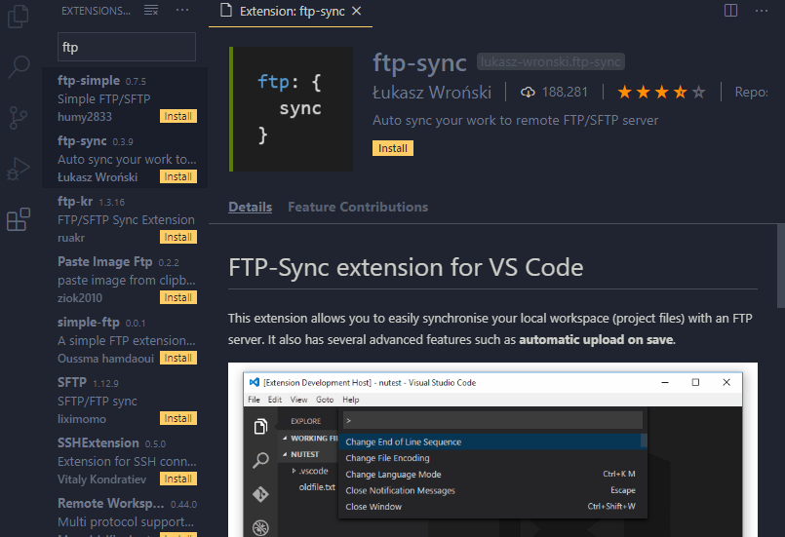
Some popular FTP programs
FileZilla
WinSCP
Cyberduck
Most IDEs have FTP clients built in, or available as extensions.

Slide 27

Components of a simple URL
path
Learn More: What is a URL?
https://developer.mozilla.org/en-US/docs/Learn/Common_questions/What_is_a_URL

Slide 28
Two ways to access a web page on the Internet
Enter the URL of a web page into the browser’s address bar.
Click on a link in the current web page to load another web page.

Slide 29
Three ways to access a web page on your own server or computer
Use the features of your text editor or IDE.
Find the file in File Explorer or Finder. Then, double-click on it to open it in your default browser. Or, right-click on it and use the Open With command to select the browser.
If your browser has a menu bar, use the File→Open or File→Open File command.

Slide 30
Naming recommendations for folders and files
Create names for folders and files that consist of lowercase letters, numbers, underscores or hyphens, and the period.
Do not use uppercase letters in filenames or directory names, to avoid issues with case-sensitive file systems.
Use filenames that clearly indicate what a page contains. This is good for search engine optimization.

Slide 31
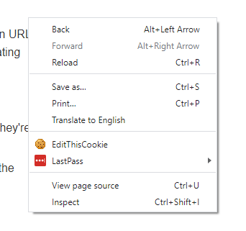
How to view the source code for a web page
In Chrome, right-click the page and select the "View page source" command.
In Chrome, the source code is displayed in a new browser tab.

Slide 32
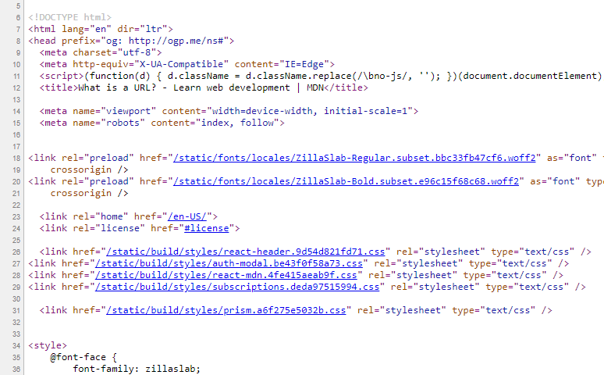
How to view the CSS code in an external CSS file
In Chrome, click on the link that refers to the CSS file.

Slide 33
Common Web Development Issues
Usability
Cross-browser Compatibility
Accessibility
Search Engine Optimization
Responsive Web Design

Slide 34
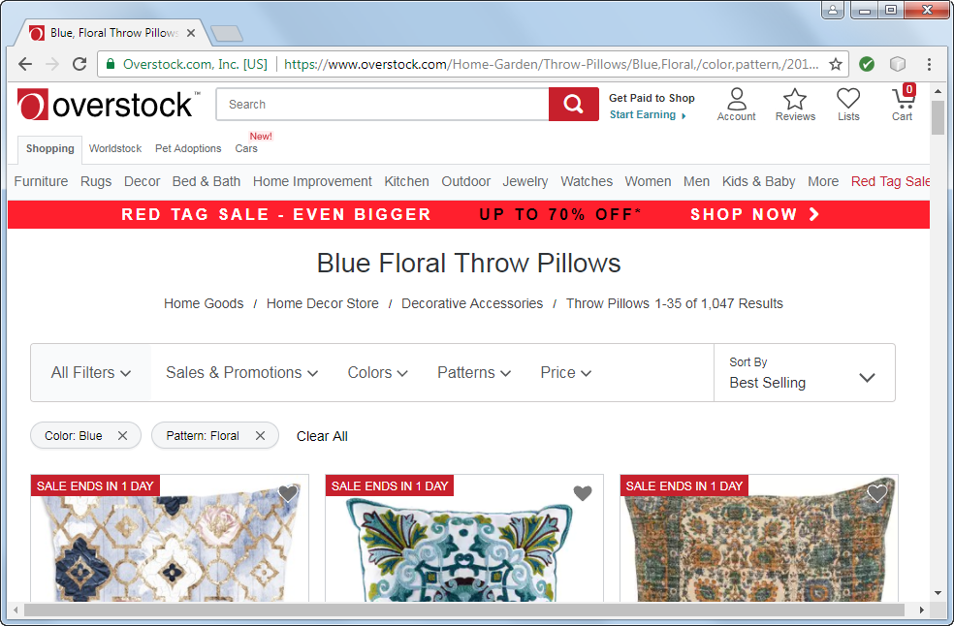
A website that is easy to use (Overstock.com)

Slide 35
What website users want is usability
To find what they’re looking for as quickly and easily as possible
To get information or do a task as quickly and easily as possible

Slide 36
How website users use a web page
They scan the page to find what they’re looking for or a link to what they’re looking for. They do not like to scroll. If they get frustrated, they leave.
They often click on links and buttons with the hope of finding what they’re looking for. They frequently click on the Back button when they don’t find it.

Slide 37
Four guidelines for improving usability
Present as much critical information as possible “above the fold”.
Group related items, but limit the number of groups on each page.
Include a header that identifies the site and provides a navigation bar.
Use current navigation conventions, like including a logo that goes to your home page when clicked and a cart icon that goes to your shopping cart when clicked.

Slide 38
Guidelines for cross-browser compatibility
Test your web pages on all of the major browsers, including older versions of Internet Explorer that are still in common use.
Use the features of HTML5 and CSS3 that are supported by all modern browsers. But use the workarounds so those features will work in older browsers too.

Slide 39
Accessibility laws that you should be aware of
The Americans with Disabilities Act (ADA).
Sections 504 and 508 of the Federal Rehabilitation Act.
Section 255 of the Telecommunications Act of 1996.

Slide 40
Types of disabilities
Visual
Hearing
Motor
Cognitive

Slide 41
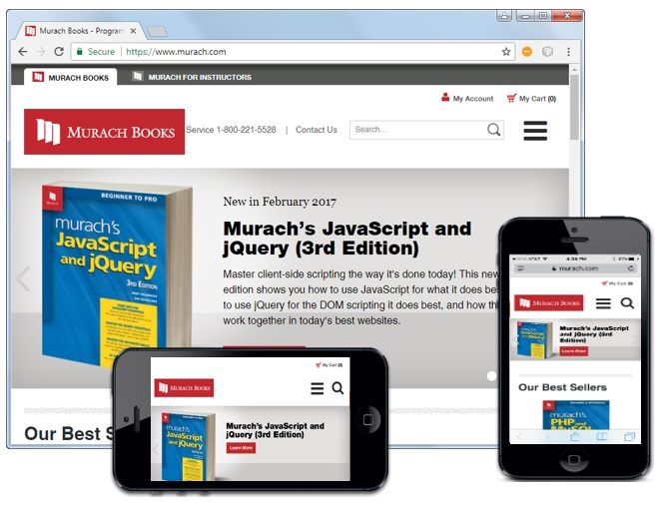
The Murach Books website on different devices

Slide 42
What is Responsive Web Design?
Responsive Web Design refers to websites that are designed to adapt gracefully to the screen size.
Typically, the overall look-and-feel of a website will remain consistent from one screen size to the next.
Media queries, scalable images, and flexible layouts are the backbone of Responsive Web Design.

Slide 43
Objectives
Applied
Load a web page into a web browser.
View the source code for a web page in a web browser.
Knowledge
Describe the components of a web application.
Describe HTTP requests and responses.
Distinguish between the way a web server processes static web pages and dynamic web pages.
Explain the purpose and use of HTML.
Explain the purpose and use of CSS.
Explain the purpose and use of JavaScript.

Slide 44
Objectives (cont.)
Discuss how you deploy a website to the Internet.
Describe the components of an HTTP URL.
Discuss these five web development issues:
Usability
Cross-browser Compatibility
Accessibility
Search Engine Optimization (SEO)
Responsive Web Design

Slide 45
Assignments
Reading assignments on Perusall
Homework and Labs on InsideRanken

